Slide 1


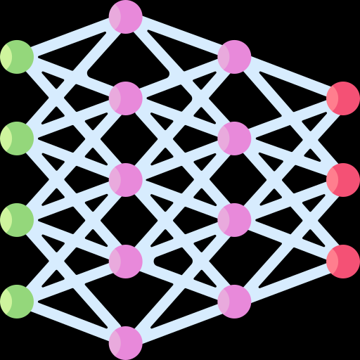

Meta-Genomics Data
FASTA reads
Ecological Sequencing
Gut Flora
Large Sets of Sequence Unlabeled
Tumor
Microbiome
Oral Microbiome
Shah-colorectal Cancer
Create Representation for Models
Sequence Of Domains
Analysis
Bag Of Domains
Large Model
Transformer Model
Healthcare Predictions
Applications
More…
Disease Phenotypes

Slide 2
Meta-Genomics Data
FASTA reads

